Slide 1

SUARA SANTRI
Continuing Education Program
Center for Computing and Information Technology
Fakultas Teknik Universitas Indonesia
Developed by
Evan Afif Saputra
Ugi Ispoyo Widodo

Slide 2
INTRODUCTION
Suara Santri is a website which provides anislamic information to users in regards with islamic history, fiqih, hadits, exemplary stories, islamic personalities, and schedule.

Slide 3



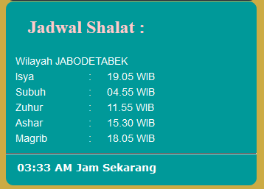

Index.html Page

Slide 4
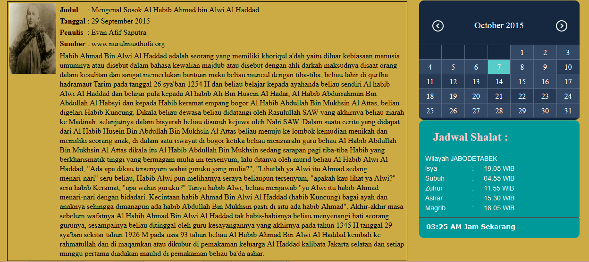
Tokoh.html Page

Slide 5
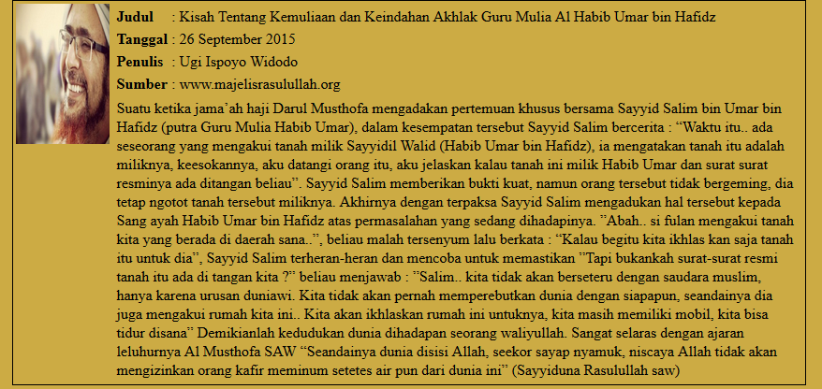
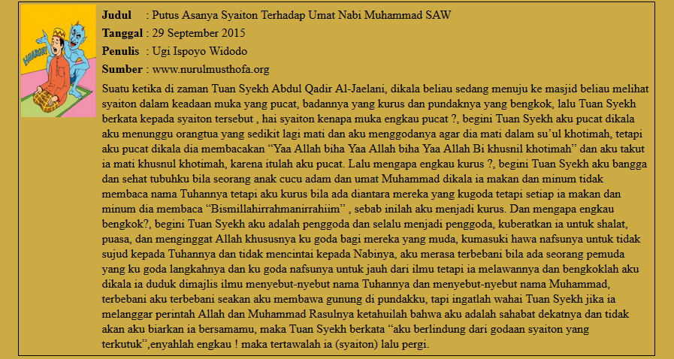
Kisah.html Page

Slide 6
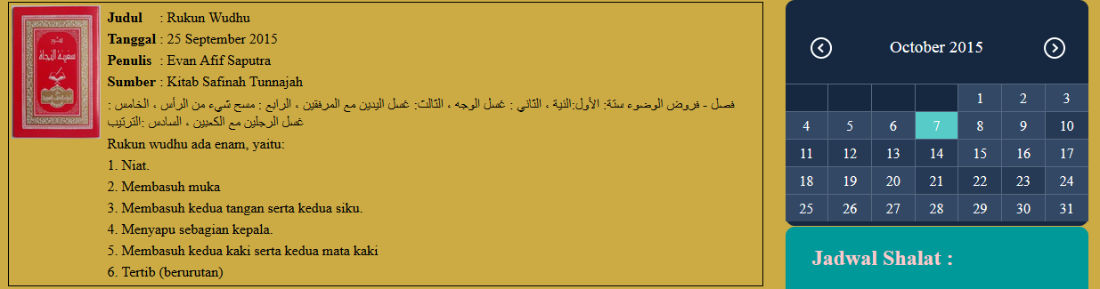
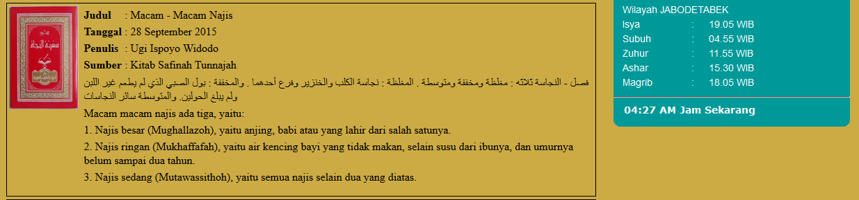
Fiqih.html Page

Slide 7
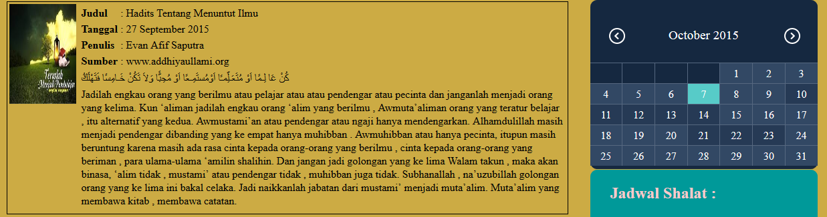
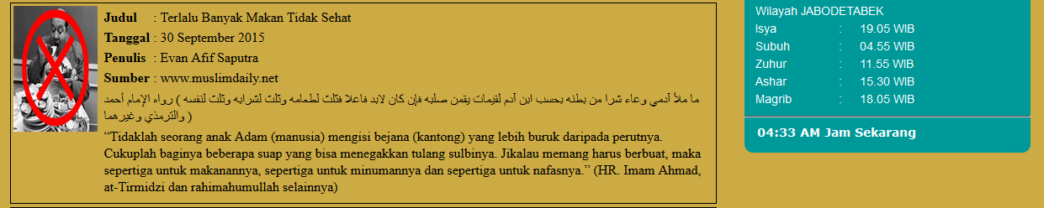
Hadist.html Page

Slide 8
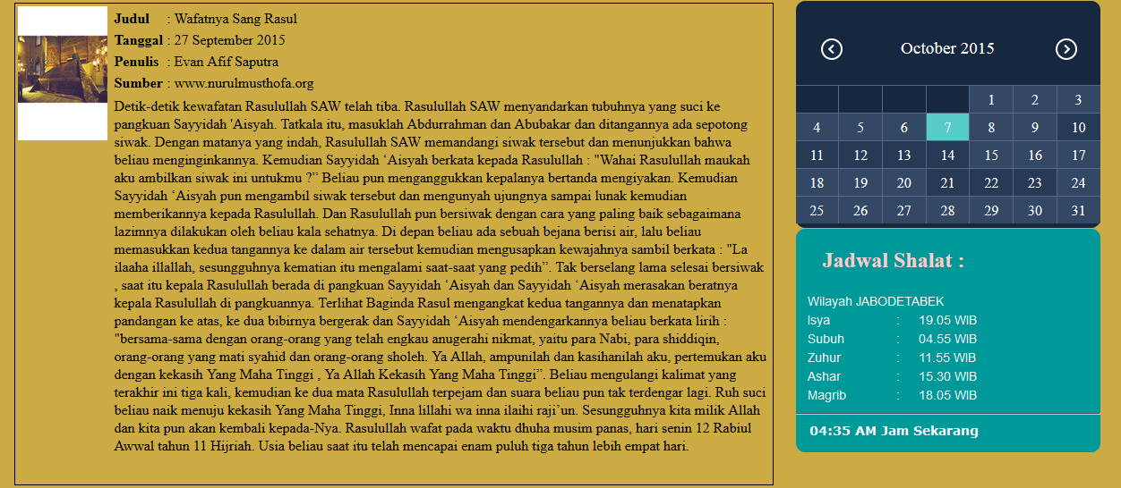
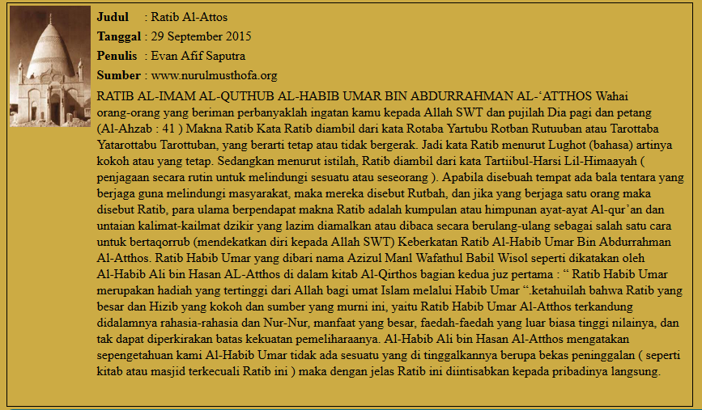
Sejarah.html Page

Slide 9
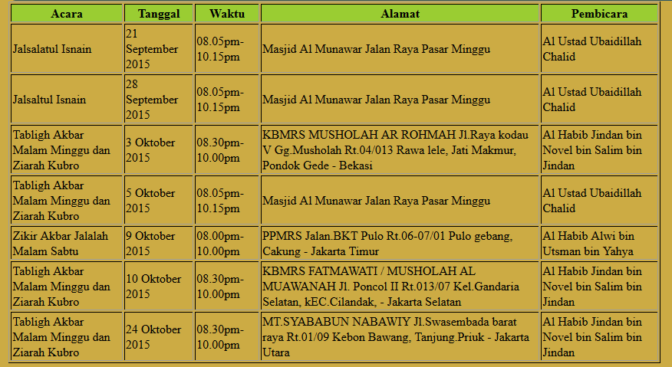
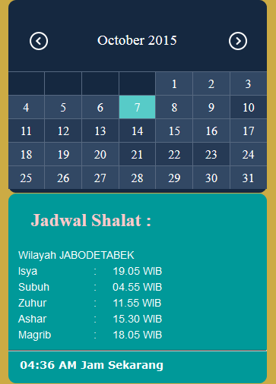
Jadwal.html Page

Slide 10
Thank You

